Slide 1
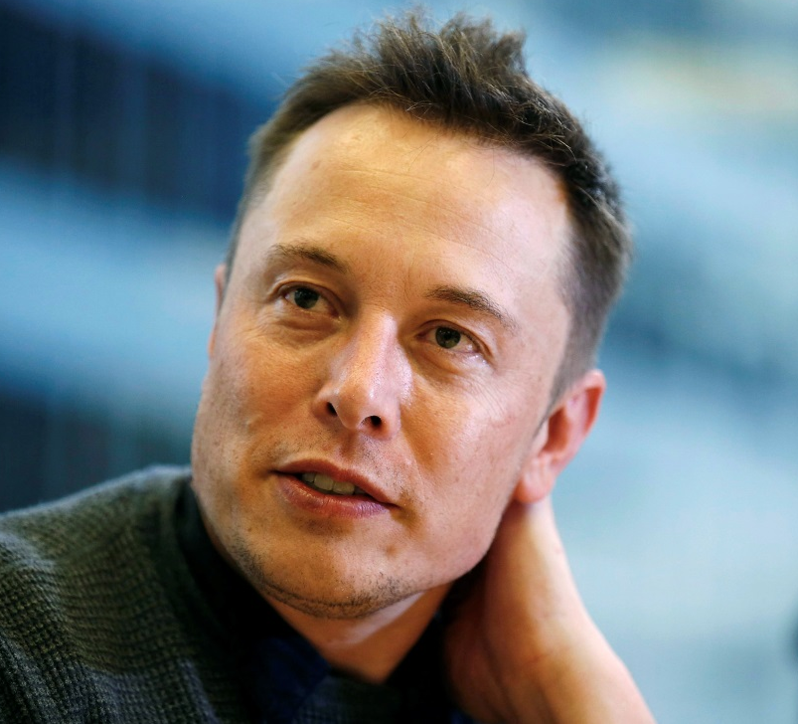
ELON MUSK

Slide 2
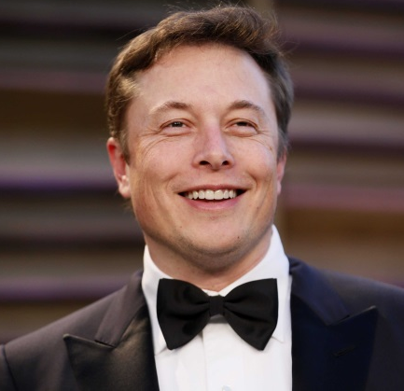
Who is This Man?
Roughly, he is entrepreneur, inventor, investor and billionaire.
Studied at University of Pennsylvania, School of Arts and Sciences (B.A. Physics, B.S. Economics).
CEO and CTO of SpaceX, CEO of Tesla Motors, Chairman of Solar City
Estimated Net Worth $21 Billion US Dollars.

Slide 3


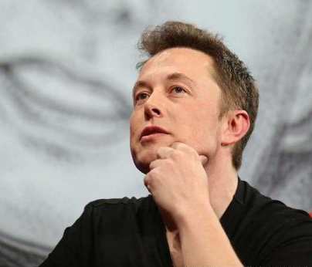
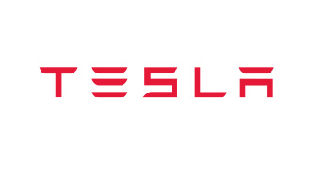

What this Man Does?

Slide 4

Musk co-founded X.com, an online financial services and payment company, in March 1999. One year later, in a 50/50 merger, X.com acquired Confinity (auction payment system).
In February 2001, X.com changed its legal name to PayPal Inc.
PayPal’s growth was due in large part to a successful viral growth campaign created by Musk.
In October 2002, PayPal was acquired by eBay for$1.5 billion in stock of which $180 million was given to Musk.

Slide 5
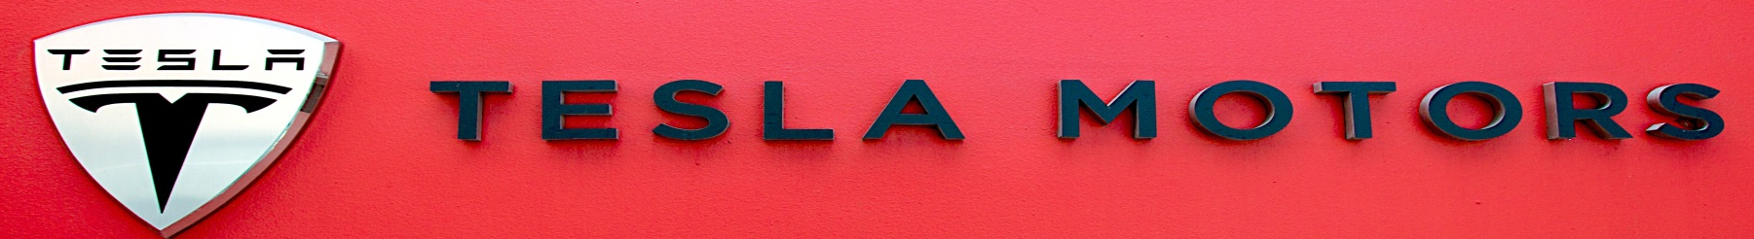
Musk is principally responsible for an overarching business strategy that aims to deliver affordable electric vehicles to mass-market consumers.
Musk’s aim is to bring other carmakers to develop electric powertrains in order to reduce the use of fossil fuels and emissions.
Musk also develop supercharger station in 2012 to facilitate longer distance journey. As of 2014, there are currently 65 stations in United States and 14 others across Europe region.

Slide 6
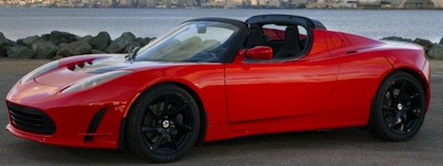
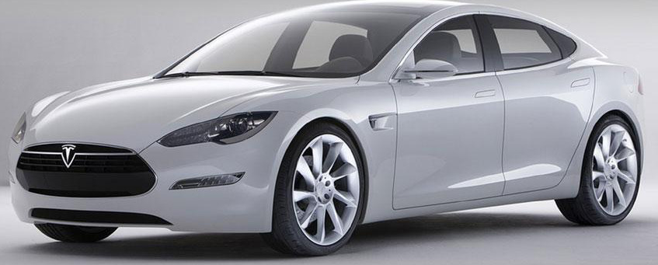
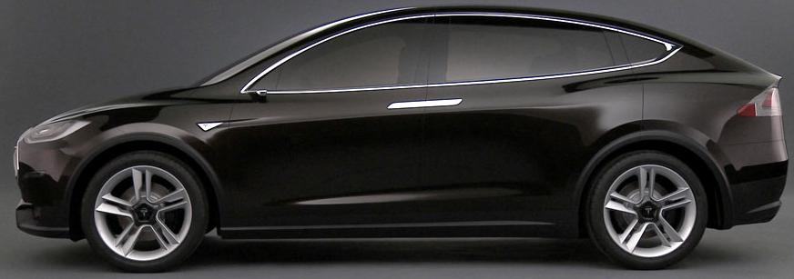
TESLA ROADSTER
TESLA MODEL S
TESLA MODEL X

Slide 7
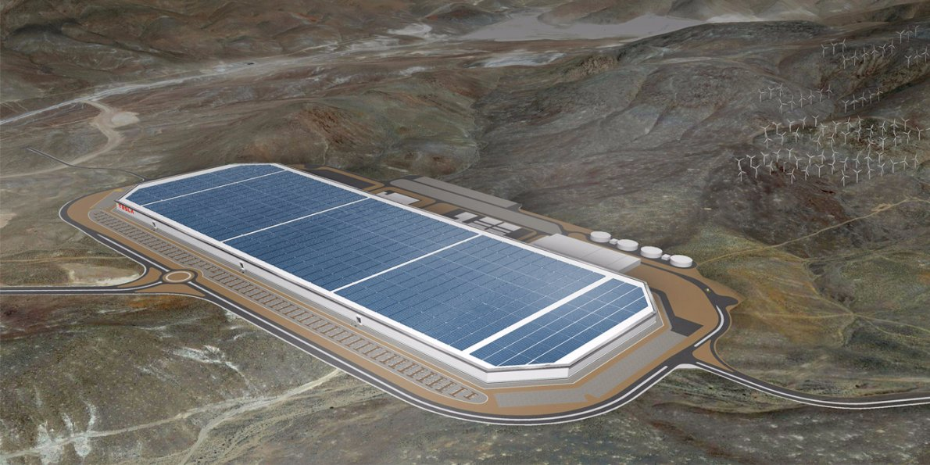
GIGAFACTORY

Slide 8
Musk founded his third company, SpaceX, in June 2002. He is currently the CEO and CTO of SpaceX.
SpaceX develops and manufactures space launch vehicles with a focus on advancing the state of rocket technology.
SpaceX was awarded a $1.6 billion NASA contract on 23 December 2008, for 12 flights of their Falcon 9 and Dragon spacecraft to the International Space Station (ISS).
SpaceX was founded with the goal of reducing space transportation costs and enabling the colonization of Mars.
The first privately funded, liquid fuelled rocket (Falcon 1) to reach orbit on 28 September 2008.
The first privately funded company to successfully launch (by Falcon 9), orbit and recover a spacecraft (Dragon) on 9 December 2010.
The first private company to send a spacecraft (Dragon) to the International Space Station on 25 May 2012.
The first private company to send a satellite into orbit.

Slide 9
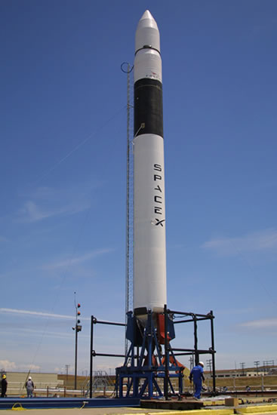
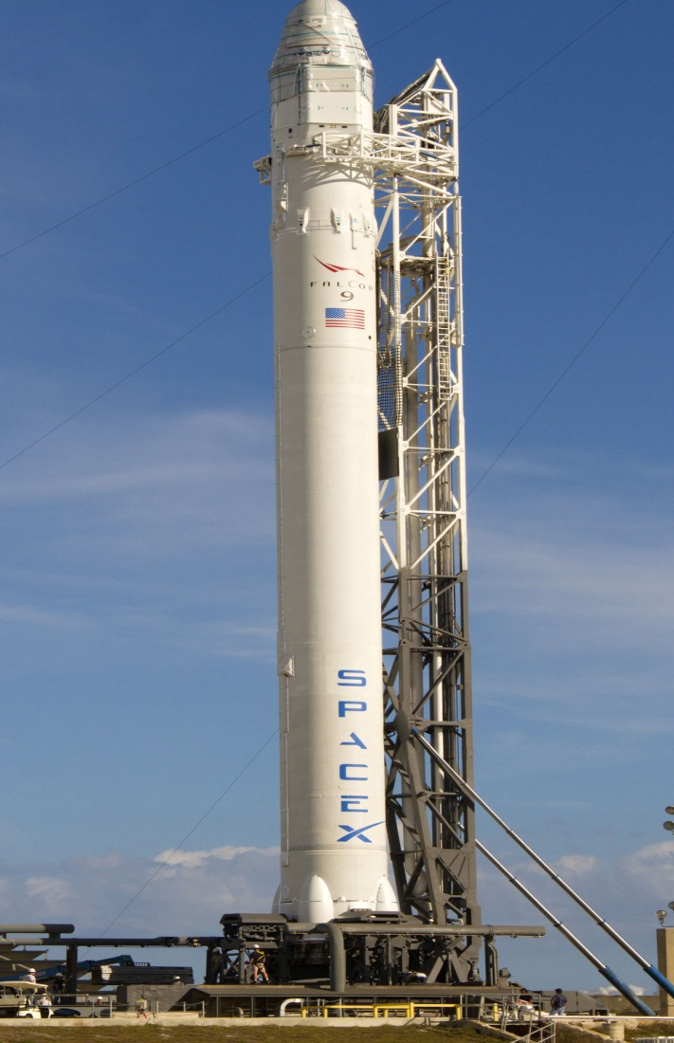
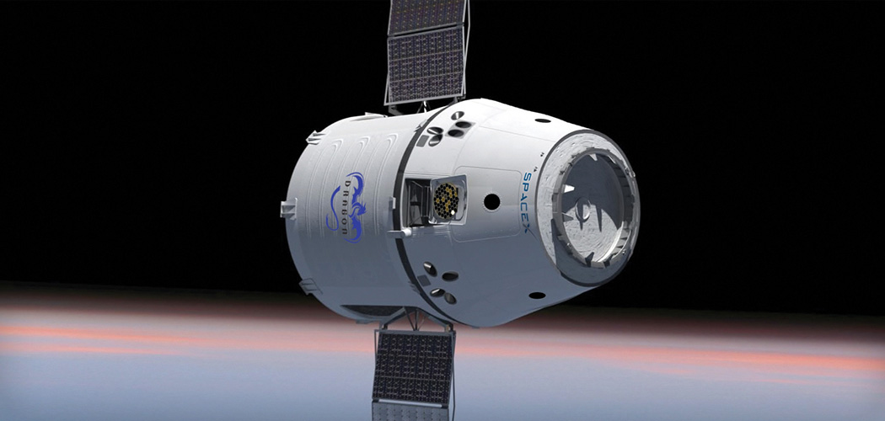
Falcon 1
Falcon 9
Dragon

Slide 10
SolarCity is an American provider of energy services to homeowners, businesses, and government/non-profit organizations.
Among its primary services, the company designs, finances and installs solar energy systems.
SolarCity has grown in recent years to meet the rapidly growing installation of solar photovoltaic systems in the United States.
Musk provided the initial concept for SolarCity, which was then co-founded by his cousins Lyndon and Peter Rive. Musk remains the largest shareholder. SolarCity is now the largest provider of solar power systems in the United States.
The underlying motivation for funding both SolarCity and Tesla is to help combat global warming.

Slide 11
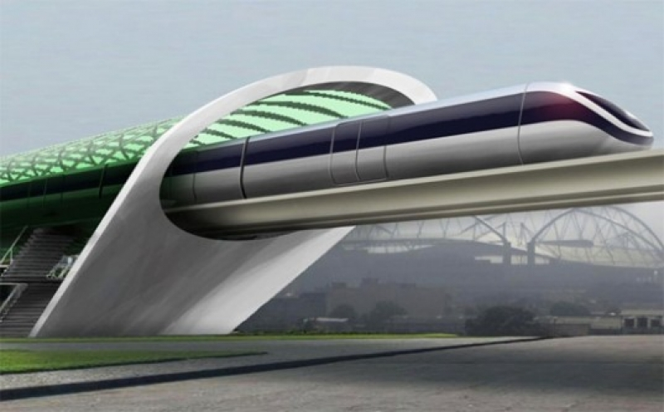
What’s Next? Hyperloop
On August 12, 2013, Musk unveiled a proposal for a new form of transportation between the Greater Los Angeles area and the San Francisco Bay Area, after being disappointed with the approved California High-Speed Rail system.
He named it "hyperloop," a hypothetical subsonic air travel machine that stretches approximately 350 miles (560 km) from Sylmar (a northern district of Los Angeles) to Hayward (east of San Francisco) and would theoretically allow commuters to travel between the cities in 30 minutes or less, providing a shorter traveling time than even a commercial airplane can currently provide.
The system is proposed to use a partial vacuum to reduce aerodynamic drag, which it is theorized would allow for high speed travel with relatively low power incorporating reduced-pressure tubes in which pressurized capsules ride on a cushion of air that is driven by a combination of linear induction motors and air compressors.
It was proposed to rely completely on solar energy for all power requirements.

Slide 12





Awards & Recognition
One of Time Magazine’s 100 people who most affected the world in 2010.
Named as one of the 75 most influential people of the 21st century by Esquire magazine.
R&D Magazine Innovator of the Year for 2007 for SpaceX, Tesla and SolarCity.
In February 2011, Forbes listed Musk as one of "America's 20 Most Powerful CEOs 40 And Under“.
In 2012, Musk was awarded with the Royal Aeronautical Society's highest award – a Gold Medal.

Slide 13
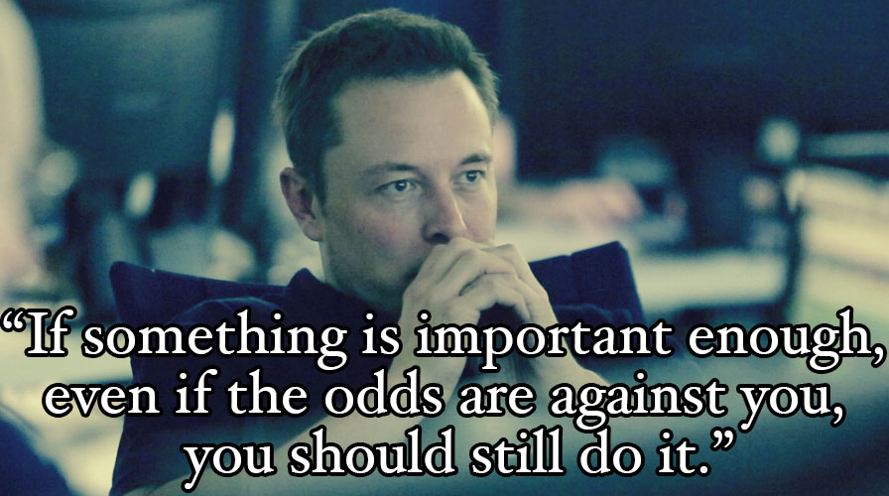
What We Can Learn from Elon Musk?

Slide 14
THANK YOU

